Slide 1


Boogle
Created by
Group 2
Nadim Uddin, Deon Shah, Reece Shah, Adil Hussain

Slide 2
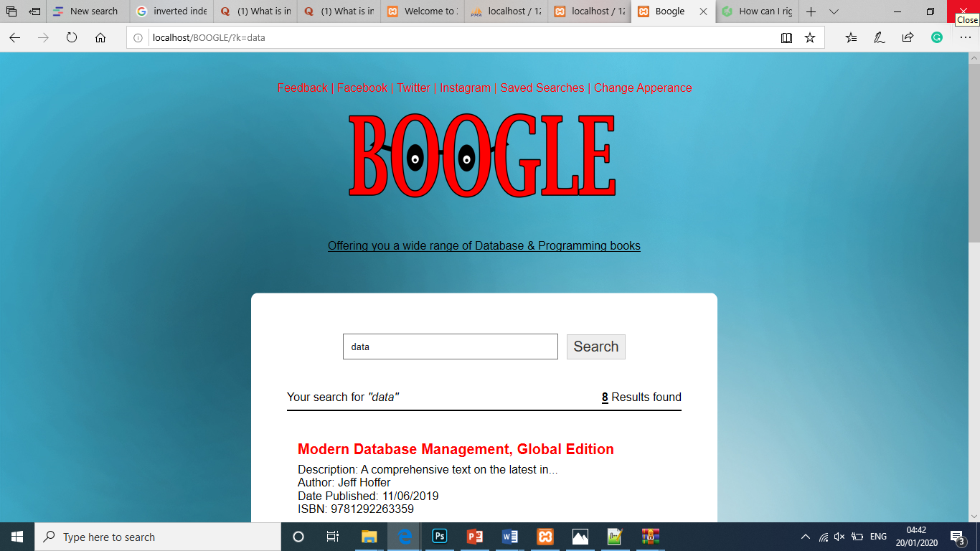
What is BOOGLE?
Our idea:
Advanced book search engine for professionals.
Providing up to date and relevant books.
Find books by either searching authors name, isbn number, keywords or even published date i.e 2018.
What makes it different?
Created by us students with the user in mind -
Easy to search and adjust search e.g. berrypicking model.
Good user interaction.
Archiving and storing user feedback.
Well presented query results.

Slide 3
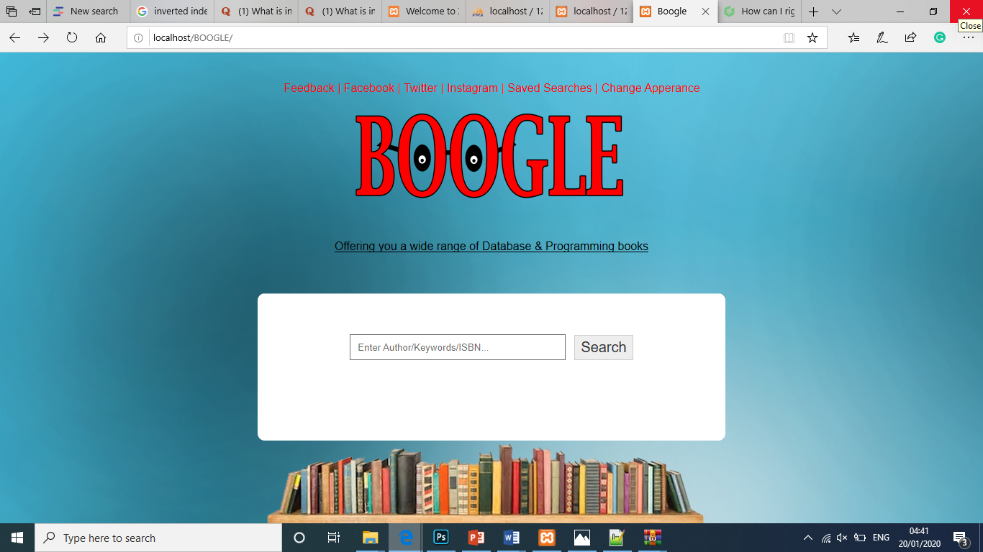
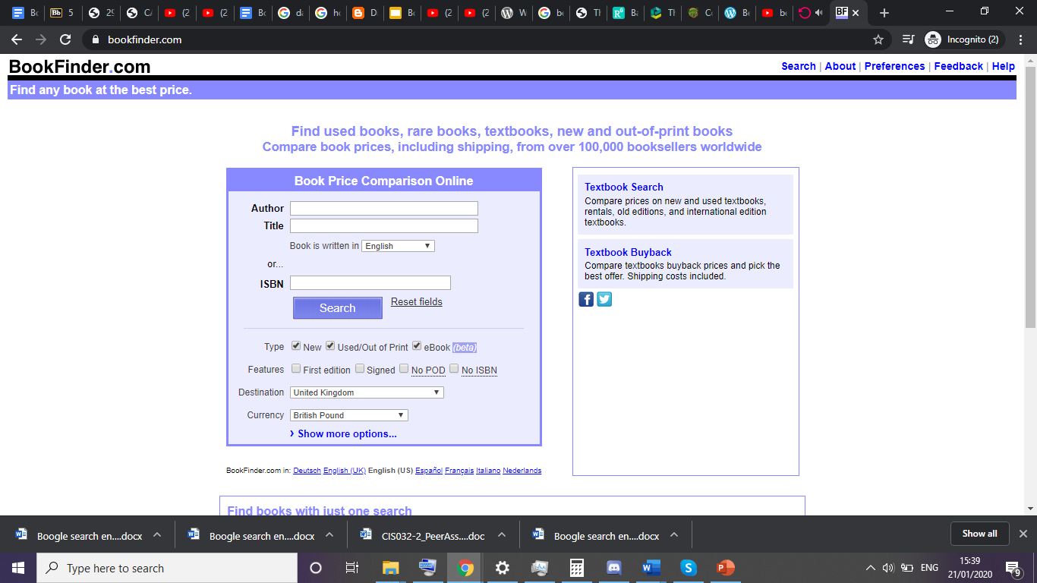
How it solves a real-world problem?

Slide 4
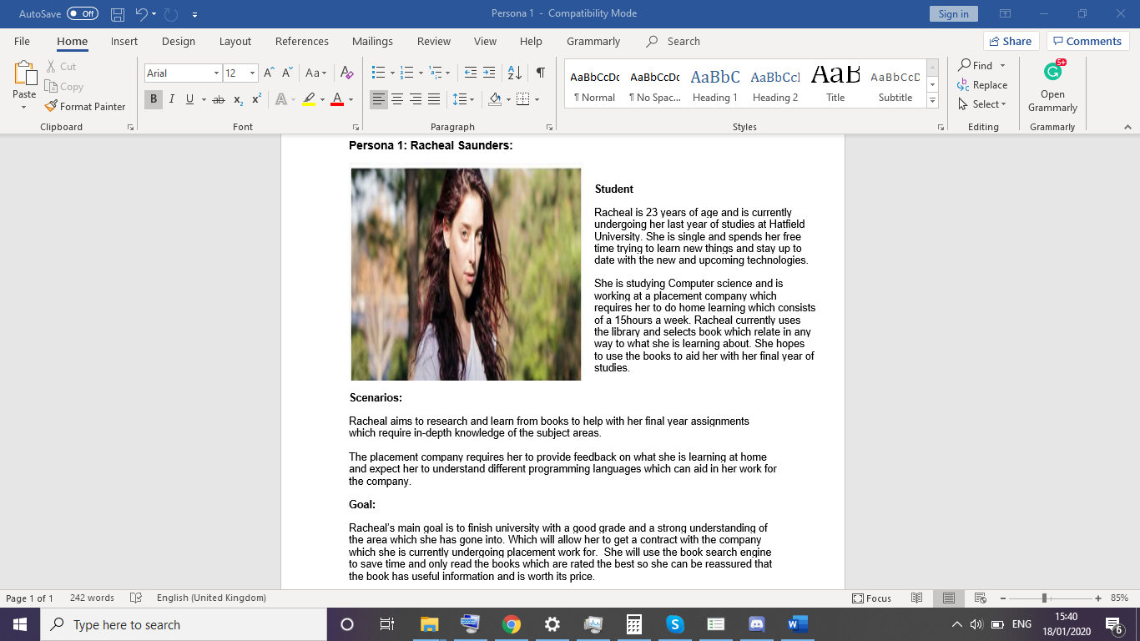
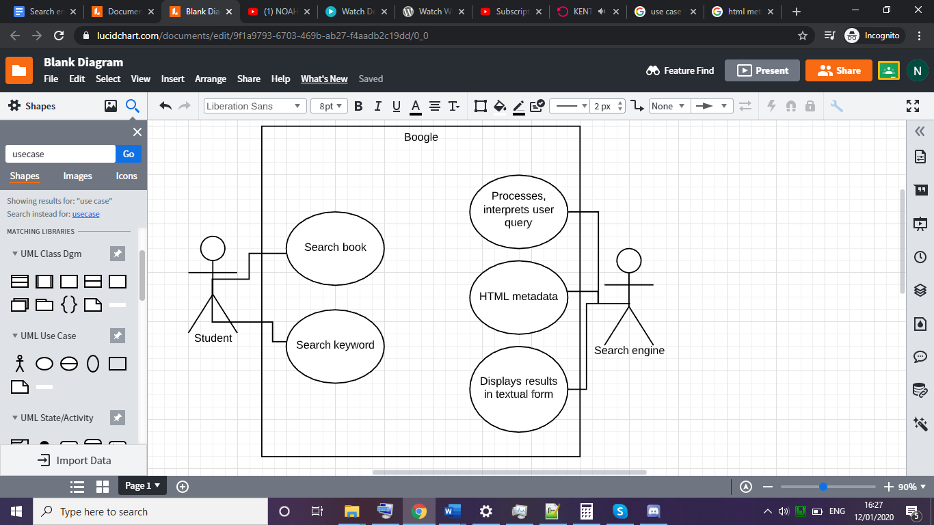
Personas w/ creation of Use-cases part 1
Prior to this we done extensive primary and secondary research which is included in the report**
Persona 1
Female student
Final year
Reading books relating to her course
Scenario
Final year assignments
Work placement requires understanding and knowledge
Goal
Finish degree
Acquire job in desired profession
Use case 1
Student uses search engine to search book
Student unsure of book so uses keywords to search
System automatically processes users query
Results are generated and can be edited if the user decides to change or edit search

Slide 5
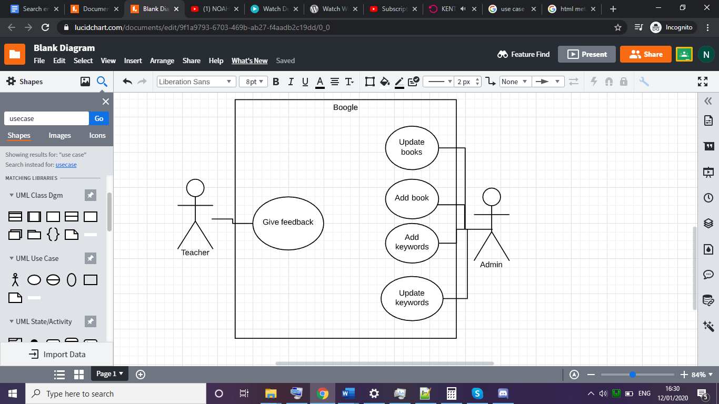
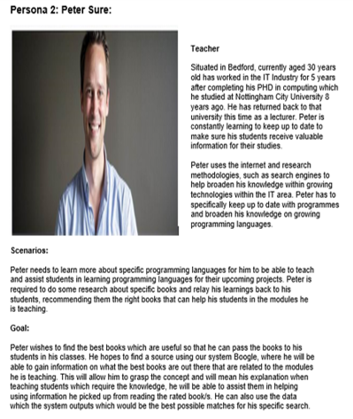
Personas w/ creation of Use-cases part 2
Prior to this we done extensive primary and secondary research which is included in the report**
Persona 2
Graduate with PHD in computing
University Lecturer
Up to date with new technology
Scenario
Needs to learn new programming languages to help students
Share good books to his students to learn from.
Goal
Relay highly reviewed and useful books to his classes.
Use a reliable search engine to search for a specific types of books.
Use case 2 : Persona 2 POV
Use case 2
Teacher can also search
Teacher can give feedback on the books.
Admin can update the mysql database

Slide 6
1a: Searching & Seeking Concepts:
Berrybatespicking Model:
Information retrieval
Previous Results
Bookmarks
Search completion

Slide 7
2b: Searching & Seeking Concepts:
Ellis Behaviour Model:
Information seeking behaviors refers to the way, in which a user searches & utilizes information
General model of search behaviour
Ellis, (1989) proposed six key activities within the information seeking process
Notes:
information seeking patterns
Information seeking behaviors reflect on the way in which a user searches
And user’s utilize information

Slide 8
Implementation of ELLIS Model strategies
Use of the basic characteristics from the ELLIS model in our system:
>Starting: Search term completion/Related terms (Activities that form the search)
>Chaining: Clickable entries on result page
>Browsing: Sort results/filter, Highlighting text in result list
>Monitoring: Saved searches
Notes:
Starting: the user would have decided to search for some piece of information and chose the search engine to try to locate their desired information. Choosing their starting terms.
Browsing: the user would decipher the results displayed to them and then be able to select the valid results displayed or not. Inevitably the search engine would display some results that the algorithm (very simple one in this case) chose. Likely to be not the right fit for the user. They may choose to continue sifting through the results. Opening pages and reading more to find their end price of information.

Slide 9
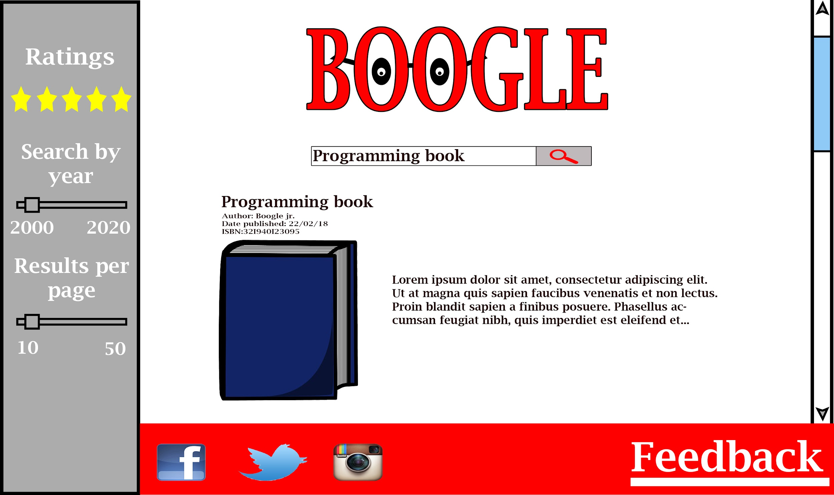
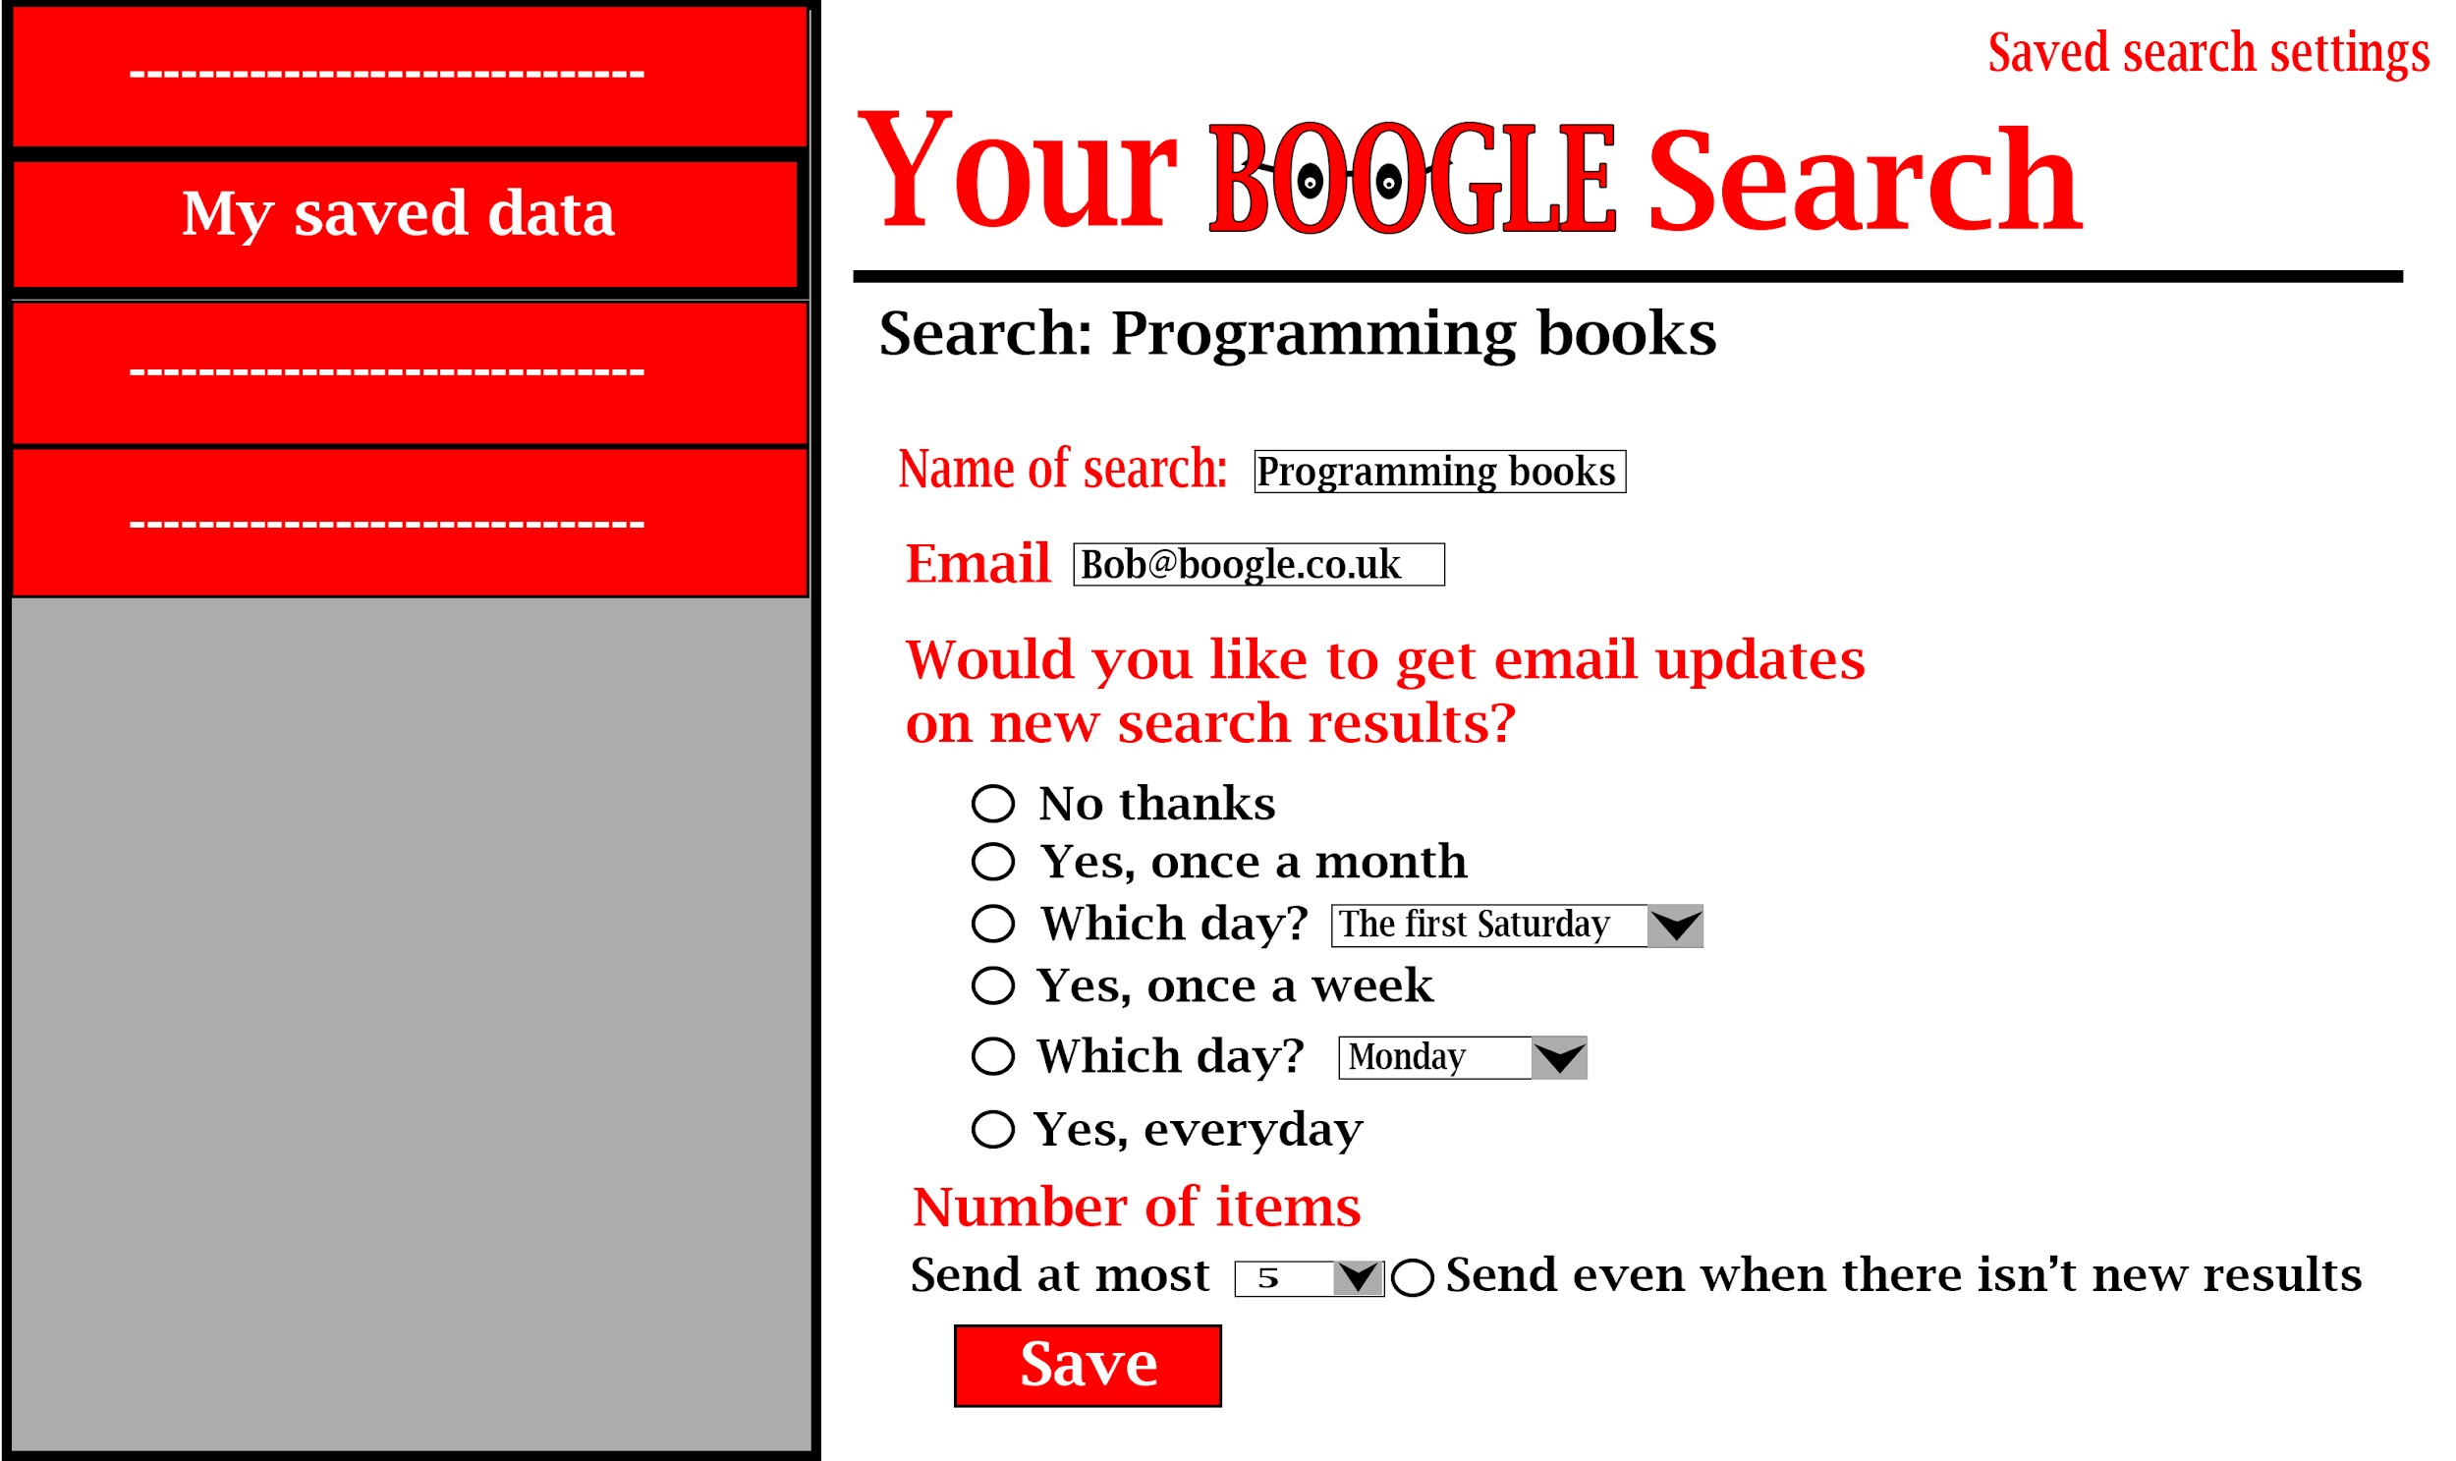
Storyboards Design
Notes:
FOllows design priciple/rules, shienndeer mann nielsen, and fknows

Slide 10
How Boogle relates to the Data Life Cycle
Creation - modern books, site links
Storage - phpmyadmin connection, indexing our books
Use - finding relevant books for the user
Dissemination - social media links
Destroy/retain - links out of date, content rating

Slide 11
References
https://www.slideshare.net/natashagandhi11/ellis-model-of-information-seeking-behaviour
http://dx.doi.org/10.1002/asi.10244.
http://ixd.prattsi.org/2018/11/berrypicking-a-discussion-based-on-batess-the-design-of-browsing-1989/

